Slide 1
INVESTMENT OPPORTUNITIES IN AZERBAIJAN March 2023
EXPORT AND INVESTMENT PROMOTION AGENCY OF THE REPUBLIC OF AZERBAIJAN - AZPROMO

Slide 2
STATE OF ECONOMY – 2021
5,452.53 USD GDP PER CAPITA
GDP
54.6
BLN USD
10.1 MİLLİON POPULATION
NON OIL GDP IN 2021: (62%)
GDP structure (%)
oil
non-oil
During 1995 – 2021:
59.3 bln usd – the volume of investment in the non-oil sector.
15.6 bln usd – the volume of FDI in the non-oil sector.
Source: State Statistical Committee of Azerbaijan

Slide 3
PROVEN TRADING PARTNER – 2021
US$ 22.2 BLN
TOTAL VALUE OF EXPORTS
US$ 11.7 BLN
TOTAL VALUE OF IMPORTS
Source: State Customs Committee of Azerbaijan

Slide 4
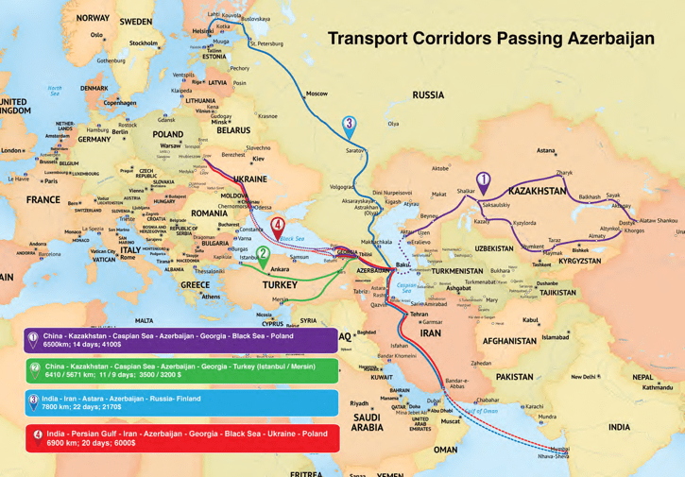
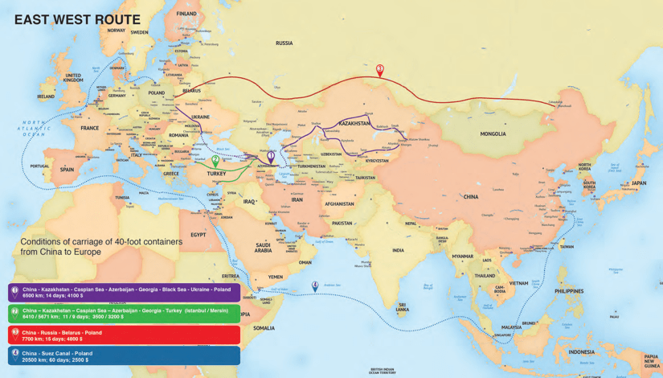
EFFECTIVE TIME SAVING ROUTES
60% TIME SAVING FOR NORTH-SOUTH ROUTE
(INDIA - EUROPE)
70% TIME SAVING (CHINA - EUROPE MARITIME ROUTE)

Slide 5
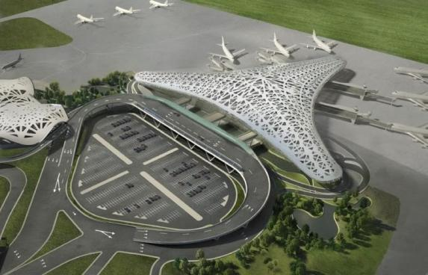
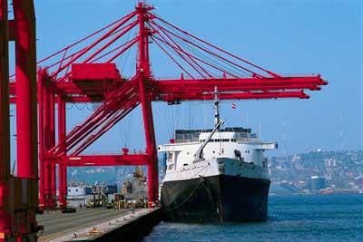
WELL DEVELOPED INFRASTRUCTURE
Almost 20 thousand km of roads and highways constructed and rehabilitated
8 new international airports, including in the liberated areas of Azerbaijan
Baku-Tbilisi-Kars railroad (“The Iron Silkway”)
New Baku International Sea Trade Port
AFEZ is a multi-modal site in a prime strategic location offering a wide range of incentives and benefits

Slide 6
STATE OIL FUND AND SOVEREIGN RATINGS
45.4 BLN.USD - AS OF JULY 1, 2022
SOVEREIGN RATINGS BY MAJOR RATING AGENCIES
SOFAZ'S PORTFOLIO BREAKDOWN BY ASSET CLASS
Standard & Poor’s
BB+, Outlook Stable
Moody’s
Ba1, Outlook Stable
Fitch
BB+, Outlook Positive

Slide 7
BUSINESS ORIENTED
ONGOING REFORM AREAS
REDUCED RED TAPE
STARTING A BUSINESS
GETTING CREDIT
DEALING WITH CONSTRUCTION PERMITS
REGISTERING PROPERTY
PROTECTING MINORITY INVESTORS
PAYING TAXES
TRADING ACROSS BORDERS
ENFORCING CONTRACTS
RESOLVING INSOLVENCY
NO STATE INSPECTIONS OF BUSINESSES
STREAMLINED LICENSING SYSTEM
E-GOV SERVICES FOR BUSINESS
STREAMLINED PUBLIC SERVICES
ONE-STOP-SHOP SYSTEMS
LOW TAX BURDEN

Slide 8
EXPORT PROMOTION
NO EXPORT DUTIES
REMOVING TRADE BARRIERS
TRADE HOUSES
CHINA
UKRAINE
POLAND
UAE
KAZAKHISTAN
BELARUS
TRADE REPRESENTATIVES
CHINA
UNITED ARAB EMIRATES
POLAND
RUSSIA
ISRAEL
TÜRKİYE

Slide 9
INVESTMENT CLIMATE
LIMITED PRICE CONTROL
TEMPORARY RESIDENCE ALLOWED UPON INVESTMENTS
NO LIMITS ON THE AMOUNT OF FOREIGN CAPITAL IN COMPANIES
NO LOCAL COUNTERPART REQUIREMENT
NO RESTRICTIONS ON REPATRIATION OF PROFITS
NO FOREIGN EXCHANGE RESTRICTIONS
NO PRIOR AUTHORIZATION OF FOREIGN INVESTMENT REQUIRED
NO DISCRIMINATION BETWEEN FOREIGN AND DOMESTIC INVESTOR
NO TECHNOLOGY TRANSFER RESTRICTIONS

Slide 10
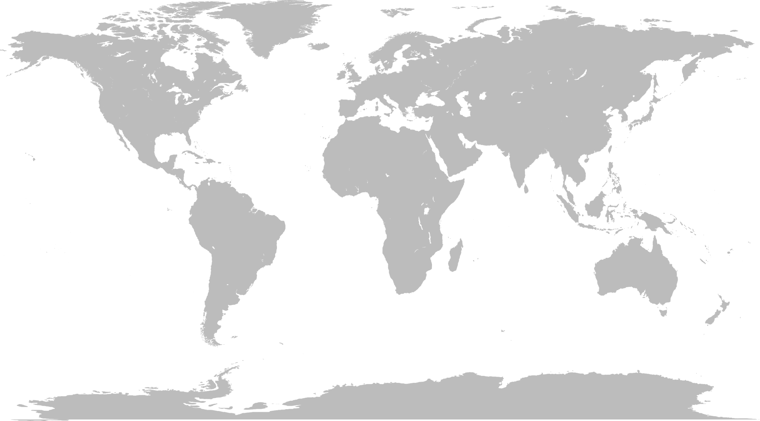
BILATERAL INVESTMENT TREATIES
ALBANIA
AUSTRIA
BELARUS
BELGIUM
BULGARIA
CROATIA
CZECH REP
ESTONIA
FINLAND
FRANCE
GEORGIA
GERMANY
GREECE
HUNGARY
ITALY
LATVIA
LITHUANIA
LUXEMBOURG
MACEDONIA FYR
MOLDOVA
MONTENEGRO
NORWAY
POLAND
ROMANIA
RUSSIA
SERBIA
SWITZERLAND
TURKEY
UK
UKRAINE
CHINA
IRAN
ISRAEL
JORDAN
SAUDI ARABIA LEBANON
PAKISTAN
QATAR
SYRIA
TAJIKISTAN
UAE
UZBEKISTAN
KAZAKHSTAN
KUWAIT
KYRGYZSTAN
KOREA REP.

Slide 11
DOUBLE TAXATION TREATIES
AUSTRIA
BELARUS
BELGIUM
B&H
BULGARIAC
CROATIA
ESTONIA
CZECH REP.
FINLAND
FRANCE
GEORGIA
GERMANY
GREECE
HUNGARY
ITALY
LATVIA
LITHUANIA
LUXEMBOURG
MACEDONIA FYR
MOLDOVA
MONTENEGRO
NETHERLANDS
NORWAY
POLAND
ROMANIA
RUSSIA
SAN MARINO
SERBIA
SLOVENIA
SPAIN
SWEDEN
SWITZERLAND
TURKEY
UK
UKRAINE
CHINA
IRAN
JAPAN
JORDAN
SAUDI ARABIA
QATAR
TAJIKISTAN
UAE
KAZAKHSTAN
KUWAIT
PAKISTAN
UZBEKISTAN
VIETNAM
KOREA REP.

Slide 12
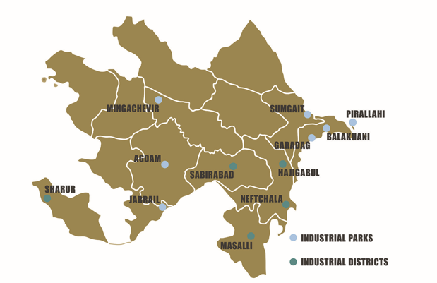
INDUSTRIAL PARKS, DISTRICTS AND AGROPARKS
STATISTICS OF INDUSTRIAL PARKS (Jan-Jun 2022)
108 business entities were granted residency status
58 residents are
already operating
PRODUCTION AND EXPORT IN INDUSTRIAL PARKS
made
6.4
bln ₼
investment
TOTAL PRODUCTION
10,100
new jobs
planned
450
mln ₼
investment
4,500
new jobs
EXPORT
Sumgait Chemical Industrial Park – 2011
Balakhani Industrial Park 2011
Mingachevir Industrial Park – 2015
Garadagh Industrial Park – 2015
Pirallahi Industrial Park – 2016
Agdam Industrial Park – 2021
Araz Valley Economic Zone – 2021
Masalli Industrial District
Neftchala Industrial District
Hajigabul Industrial District
Sabirabad Industrial District
Sharur Industrial District
51 Agroparks

Slide 13
INVESTMENT INCENTIVES
HOLDERS OF INVESTMENT PROMOTION DOCUMENT
RESIDENTS OF INDUSTRIAL AND TECHNOLOGY PARKS
7
Y
E
A
R
S
50% reduced corporate tax
0% land and property tax
0% vat on hardware, technological equipment and structures imported by IPD holders
0% customs duty on hardware, technological equipment and structures imported by IPD holders
10
Y
E
A
R
S
0% corporate tax
0% land and property tax
0% vat on hardware, technological equipment and structures imported by residents
7
Y
E
A
R
S
0% customs duty on hardware, technological equipment and structures imported by residents

Slide 14
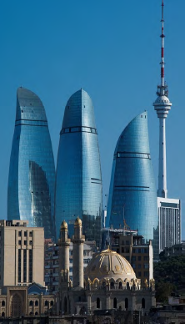
SECTOR OPPORTUNITIES
AGRICULTURE
FOOD PROCESSING
CHEMICAL INDUSTRY
RENEWABLES
TRANSPORT AND LOGISTICS
INFORMATION AND COMMUNICATION
TECHNOLOGIES
LIGHT INDUSTRY
TOURISM

Slide 15
MAJOR ACTIVITIES OF AZPROMO
IN FIELD OF EXPORT
IN FIELD OF INVESTMENT
NON-OIL EXPORT PROMOTION
PROMOTION OF “MADE IN AZERBAIJAN” BRAND
SUPPORT TO EXPORTERS
BUILDING AND PROMOTING EXPORT CULTURE
POLICY ADVOCACY
ATTRACTION
RETENTION and EXPANSION
AFTERCARE
POLICY ADVOCACY
COUNTRY’S IMAGE BUILDING

Slide 16
THANK YOU!
AZ1000, Azerbaijan, Baku,
32 Neftchilar avenue, (Baku Business Center)
Tel.: (+994 12) 598 01 47/48
Fax.: (+994 12) 598 01 52
E-mail: office@azpromo.az
www.azpromo.az

